Slide 1

MUSIC MOOD CLASSIFICATION
NHÓM 24
Nguyễn Hoàng Tân
Nguyễn Minh Trí
Đỗ Trí Nhân
Huỳnh Thanh Vy

Slide 2
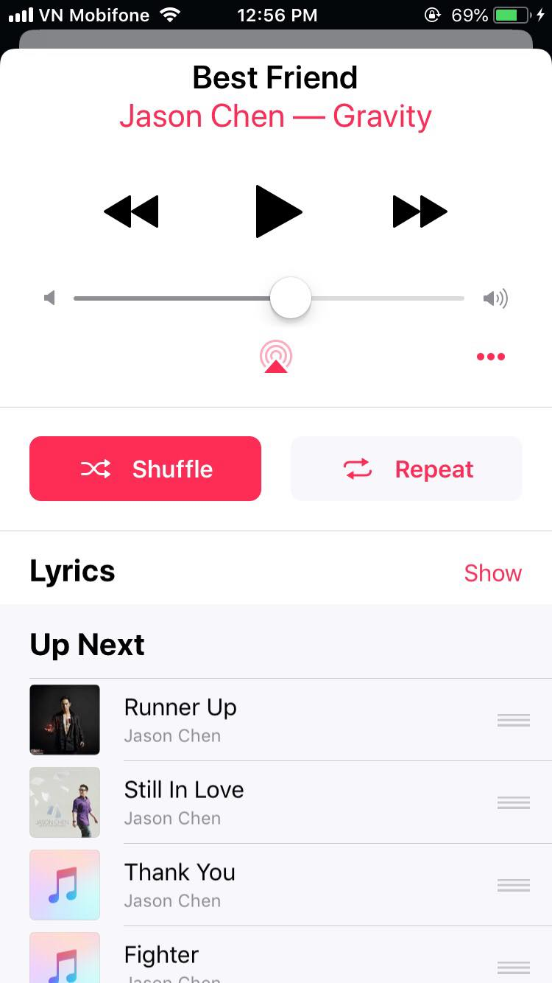
Motivation
Since the shuffle function doesn’t suggest her the similar song for our mood.
A good chance for all of us to study about machine learning.
Similar projects is available.
Objective
Making an AI function that can suggest a similar song base on the mood of the first song user selected.
Apply this to shuffle function, which can be used offline.
Break the objective into small objectives
Nhóm 4

Slide 3
Define mood of each song
Classify song base on its mood
Recommendation function base on mood.
Break the objective into small objectives
Nhóm 4

Slide 4
Heuristic
Step 1: Find the similar project that have a dataset.
Step 2: Reimplement the project to get the result as the first result
Step 3: Classify music by our own method and get the second result
Step 4: Compare the first result to the second result
Nhóm 4

Slide 5
Dataset
Feature analysis and metadata from Million Song Dataset (The Echo Nest)
1200 songs, 2 Mood, removed all non-English songs
labeled as happy and sad (by Sebastian Raschka University of Wisconsin-Madison)
Train: 1000 song
Validate: 200 song
Nhóm 4

Slide 6
Methodology
Author’s method
Our method
Built upon on a Naive Bayes classifier.
Use both audio features and lyrics to measure.
Try manual
Use Deep learning
Nhóm 4

Slide 7
Lyrics
Downloaded from http://lyrics.wikia.com
Base on metadata
Nhóm 4

Slide 8
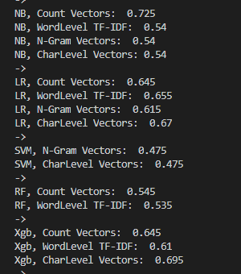
Author Method
-Naïve Bayes
-Linear Classifier
-SVM
-Bagging
-Boosting Model
-Couter Vector
-TF-IDF
-Ngram (BoW)
PRE 88.89%
ACC 72.5%
Reimplement base on paper
Nhóm 4

Slide 9

Manual method: lexicon-based
Happy
Sad
-Build Trie
-Add Song to Trie
-Check Test Song
=> 48 %
-Stopword
-Balance Dataset
=>55%
Nhóm 4

Slide 10
Deep Learning:
Preprocessing:
Remove
Stopword
punctuations
Lemmatization
Exaggerated word shortening
Stemming !!!
Nhóm 4

Slide 11
Feature
Frequency
Count Vectors
TF-IDF
Co-Occurrence Matrix
Word Embedding
Prediction
CBOW
FastText
(English Word Vector)
1M: 16B token
2M: 600B token
Skip-Gram
Nhóm 4

Slide 12
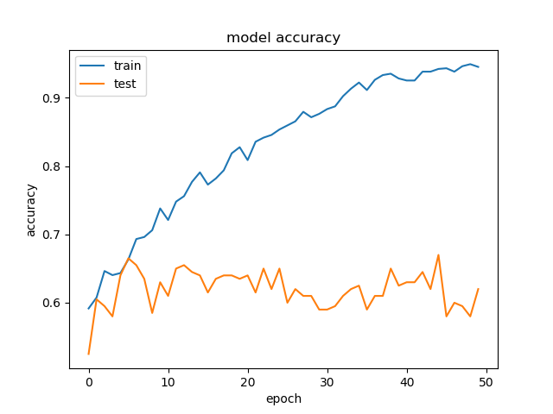
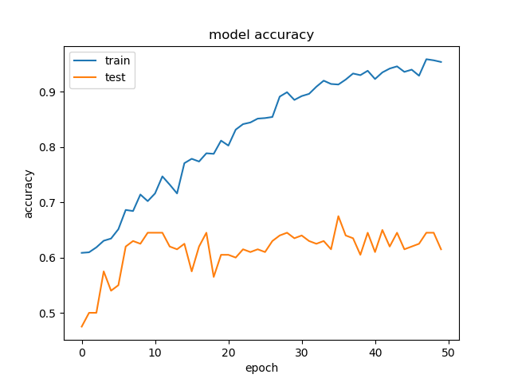
LSTM GRU
Model: RNN
64% 68%
Nhóm 4

Slide 13
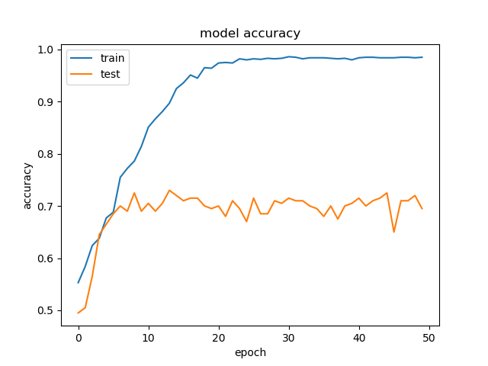
Model: CNN
Stopword
Lema
71.5%
74.5% (best case)
Nhóm 4

Slide 14
Audio
Nhóm 4

Slide 15
MFCC features
The shape of the vocal tract including tongue, teeth etc determines what sound comes out
The shape of the vocal tract manifests itself in the envelope of the short time power spectrum, and the job of MFCCs is to accurately represent this envelope
Nhóm 4

Slide 16
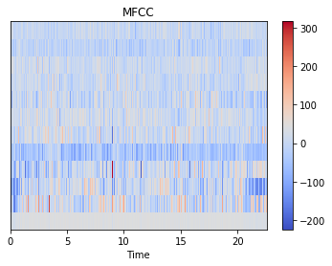

MFCC features retrive from dataset
Nhóm 4

Slide 17
Training model
Input_1 | Input | (None, 814, 12)
 | Output | (None, 814, 12)
Time_distributed_1: Dense_1 | Input | (None, 814, 12)
 | Output | (None, 814, 64)
Time_distributed_2: Dense_2 | Input | (None, 814, 64)
 | Output | (None, 814, 64)
LSTM | Input | (None, 814, 64)
 | Output | (None, 256)
Dense_3 | Input | (None, 256)
 | Output | (None, 1)
Nhóm 4

Slide 18
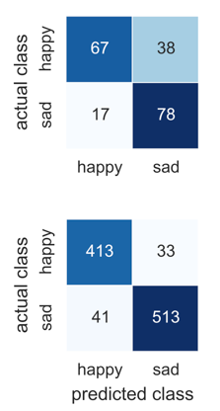
Compare the results
The existed method
Hand label: 67+38 happy songs
Model label: 67 songs, 38 songs were labeled wrongly
Nhóm 4

Slide 19
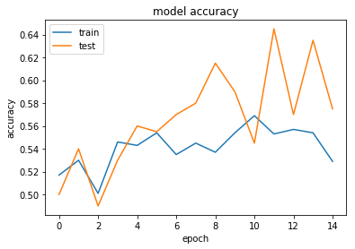
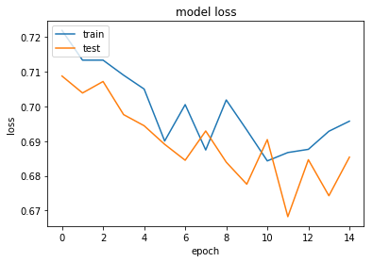
Our method Initial result
LSTM networks
Nhóm 4

Slide 20
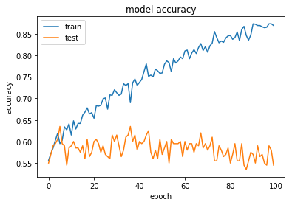
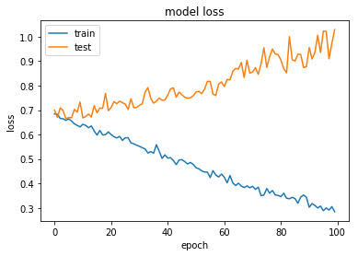
Our method Initial result
LSTM networks
Nhóm 4

Slide 21

Let’s try it in real life 2 song to let the model predict Oasis – Morning Glory 49% sad Xi Guan Liang Ge Ren 80% sad
Nhóm 4

Slide 22
Future work
Combine both audio features and lyrics
Trying Lexicon based model in NLP
Apply Treebank to RNTN (Recursive Neural Tensor Network) in Deep learning)
Apply adjective annotation dataset
Try Golve, Word2vec, self-train in embedding step
Use different song’s mood grid (spotify and gracenote)
Testing on large and more precise, mood dataset
Nhóm 4

Slide 23
References
Dataset: https://github.com/rasbt/musicmood
Paper: https://arxiv.org/abs/1611.00138
Method deeplearning: https://www.analyticsvidhya.com
Nhóm 4

Slide 24
Thank You
NHÓM 4
Nguyễn Hoàng Tân
Nguyễn Minh Trí
Đỗ Trí Nhân
Huỳnh Thanh Vy
Nhóm 4

